Slide 1






March Data Crunch Madness
Sponsored By:
Team X:
Tu Ho, Piper Hofstetter, Pan Hu, Erin Ziccarelli

Slide 2

Goal
Using historical NCAA tournament data create an optimized model to predict the 2024 NCAA final four

Slide 3

Table of contents
01
02
03
04
05
Variable Selection
Model Comparison
Coach Winning Probability
Interview Insights
2024 Predictions

Slide 4
Variable Selection
Additional Variables Added to the Dataset
Distance from hometown to each host location
Upset for games between difference seeded team
Further steps
Calculate the difference between the team variables
Feature selection based on the correlation of the difference to target

Slide 5
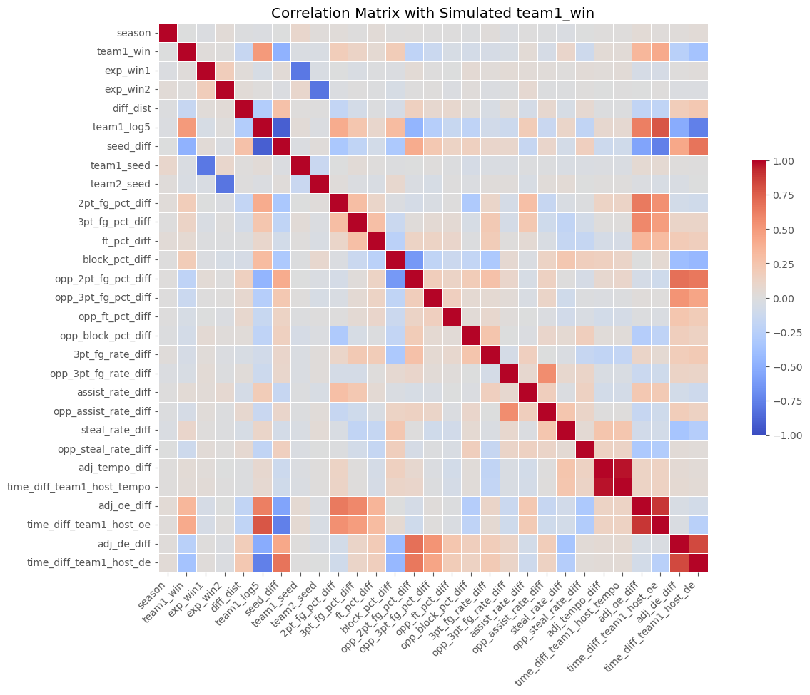
Variable Selection
Fig. 1: Correlation Matrix including all the variables

Slide 6
Variable Selection
Team 1 Winning Probability | Adjusted Tempo Difference | Coach NCAA Tournament Appearances Difference | Coach Overall Losses Difference | Opponent Steal Rate Difference
Time Difference Team 1 to Host (oe) | Assist Rate Difference | School NCAA Sweet 16 Appearances Difference | Opponent 2 PT FG % Difference | Adjusted Defensive Efficiency Difference
Adjusted Offensive Efficiency Difference | Time Difference Team 1 to Host (tempo) | Coach NCAA Sweet 16 Appearances Difference | Opponent 3 PT FG % Difference | Time Difference Team 1 to Host (de)
Block % Difference | Team 1 Expected Winning Percentage | School Final Four Appearances Difference | Opponent Free Throw % Difference
2 PT FG % Difference | Team 2 Expected Winning Percentage | Coach Final Four Appearances Difference | Opponent Block % Difference
3 PT FG % Difference | Team Season Wins Difference | Coach Season Wins Difference | Opponent 3 PT FG Rate
Steal Rate Difference | Team Season Losses Difference | Coach Season Losses Difference | 3 PT FG Rate Difference
Free Throw % Difference | School NCAA Tournament Appearances Difference | Coach Overall Wins Difference | Opponent Assist Rate Difference
Used for modeling

Slide 7
Model Comparison
 | Decision Tree | Logistic Regression | ANN | Random Forest | XG BOOST TREE
Precision | 0.91 | 0.71 | 0.70 | 0.91 | 0.93
Recall | 0.91 | 0.71 | 0.70 | 0.91 | 0.93
F1 Score | 0.91 | 0.71 | 0.70 | 0.91 | 0.93
ROC AUC | 0.9107 | 0.8007 | 0.7812 | 0.9661 | 0.9856
By looking at the evaluation metrics including Precision, Recall, F1 score and ROC_AUC, we can highlight the model that have performed well in 2024 predictions.
XG BOOST TREE had highest performance metric in the model evaluation and was chosen to proceed in predicting our outcomes.

Slide 8
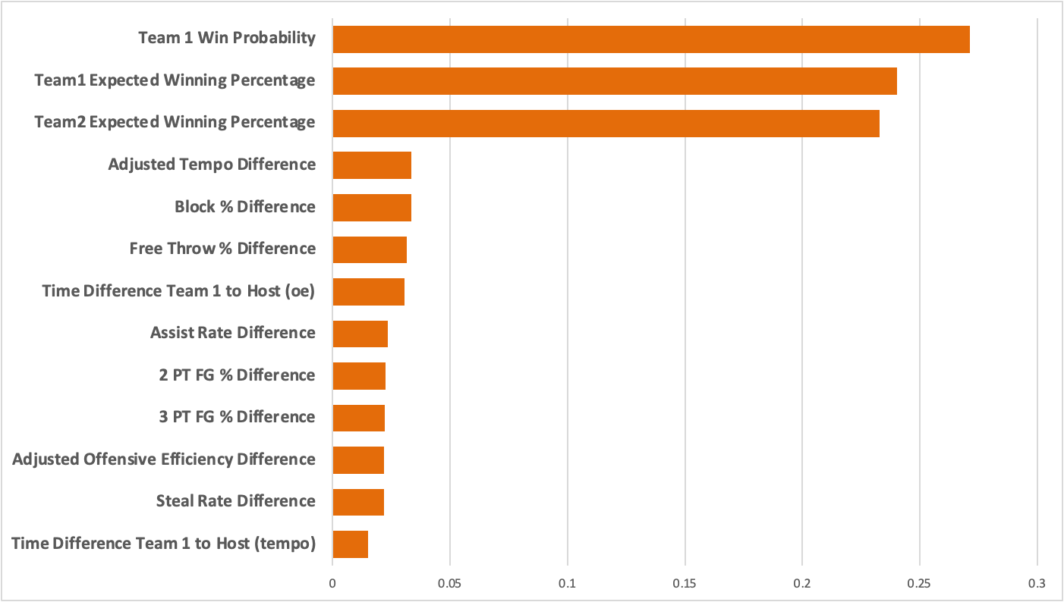
Top 3 factors influence the likelihood of team 1 winning include Team 1 Win Probability and Expected Winning Percentage of Team 1 and Team 2, followed by other variables
Fig. 2: Top 10 Predictors for the winning outcomes

Slide 9
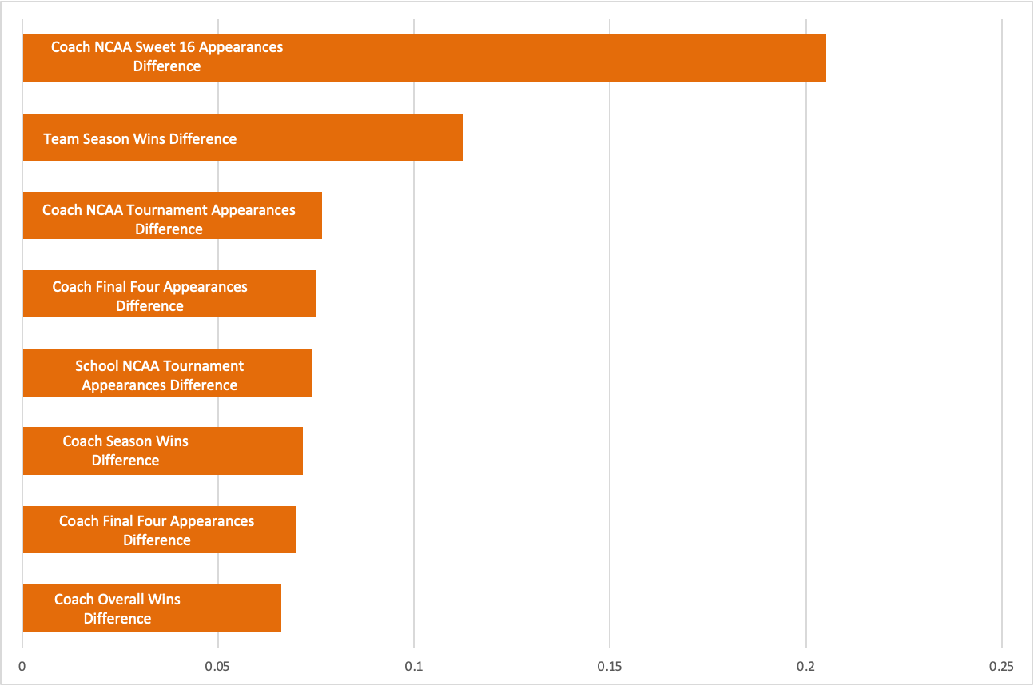
Coach Winning Probability
Estimate impact of coach performance on the probability of the team winning.
Model was built based on historical data with team1_win as target variable
Only use coach data statistics
XG Boost Tree with 70% training/30% testing
Performance on Historic Data
XG BOOST TREE
Precision: 0.62
Recall: 0.62
F1 Score: 0.61
Fig. 3: Top 8 predictors for coach winning probability

Slide 10

Interview Insights
Predictive
Variables
“A strength of schedule could make a team’s losses more understandable”
—Professor Russell Fink
1
Rebounds per game
2
Scoring offense
3
Scoring defense
Past
Upsets
X Factors
Bench
Performance
Three point percentage
Turnovers per game
Winning percentage
Strength of conference
Strength of schedule
Examine lower seeded teams
12 seeds that have beaten higher seeds in recent tournaments
Analyze team bench strength (beyond starters)
Top bench players for each team

Slide 11




2024 Predictions
Duke
Purdue
UConn
North Carolina

Slide 12

CHAMPION
UConn
EAST
SOUTH
Duke
UConn
Purdue
North Carolina
WEST
MIDWEST
Purdue

